Slide 1

IBM Data Science Capstone

Slide 2
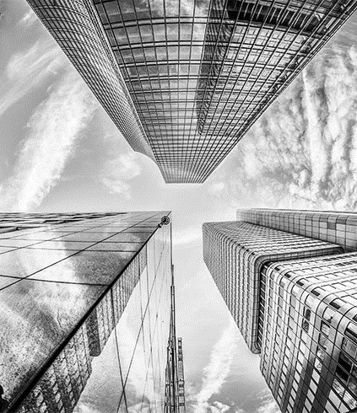
The Battle of Neighborhoods
Finding the best place to build a Restaurant in Germany.

Slide 3
Business Problem
In this project we will attempt to locate an ideal area for a restaurant. In particular, this report will be focused to partners keen on opening an Italian restaurant in Berlin, Germany.
Since there are loads of restaurant in Berlin we will attempt to identify areas that are not previously crowded with restaurant.
We are likewise especially keen on zones with no Italian restaurant in city. We would likewise favor areas as near downtown area as could be expected, accepting that initial two conditions are met.
We will utilize our data science knowledge to create a couple of most promising neighborhoods dependent on this measures. Points of interest of every region will at that point be obviously communicated so most ideal last area can be picked by partners.

Slide 4
Data
In view of our problem, factors that will impact our decision are:
number of existing cafés in the area (any sort of eatery)
number of and distance to Italian eateries in the area, assuming any number of and distance to Italian eateries in the area, assuming any
distance of neighborhood from downtown area
We chose to utilize consistently divided network of areas, based on downtown area, to characterize our areas.
Following information sources will be expected to extricate/produce the necessary data:
focuses of competitor zones will be produced algorithmically and rough locations of focuses of those zones will be gotten utilizing Google Maps API invert geocoding
number of cafés and their sort and area in each local will be gotten utilizing Foursquare API
facilitate of Berlin focus will be acquired utilizing Google Maps API geocoding of notable Berlin area (Alexanderplatz)

Slide 5
Data
In view of our problem, factors that will impact our decision are:
number of existing cafés in the area (any sort of eatery)
number of and distance to Italian eateries in the area, assuming any number of and distance to Italian eateries in the area, assuming any
distance of neighborhood from downtown area
We chose to utilize consistently divided network of areas, based on downtown area, to characterize our areas.
Following information sources will be expected to extricate/produce the necessary data:
focuses of competitor zones will be produced algorithmically and rough locations of focuses of those zones will be gotten utilizing Google Maps API invert geocoding
number of cafés and their sort and area in each local will be gotten utilizing Foursquare API
facilitate of Berlin focus will be acquired utilizing Google Maps API geocoding of notable Berlin area (Alexanderplatz)

Slide 6
Data
Neighborhood Candidates
We will create latitude & longitude coordinates for centroids of our up-and-comer areas. We will make a framework of cells covering our territory of interest which is approx. 12x12 kilometers based on Berlin downtown area.
We will find the latitude & longitude of Berlin city center using Google Map's Geocode API
We will create a zone of up-and-comers, equally divided, based on downtown area and inside ~6km from Alexanderplatz. Our areas will be characterized as roundabout regions with a range of 300 meters, so our local places will be 600 meters separated.
To accurately calculate distances, we need to make our zone of areas in Cartesian 2D coordinate system which permits us to ascertain distances in meters (not in latitude/longitude degrees). At that point we'll extend those directions back to latitude/longitude degrees to be shown on Folium map. So, we should make functions to convert between WGS84 spherical coordinate system (latitude/longitude degrees) and UTM Cartesian coordinate system (X/Y facilitates in meters).

Slide 7
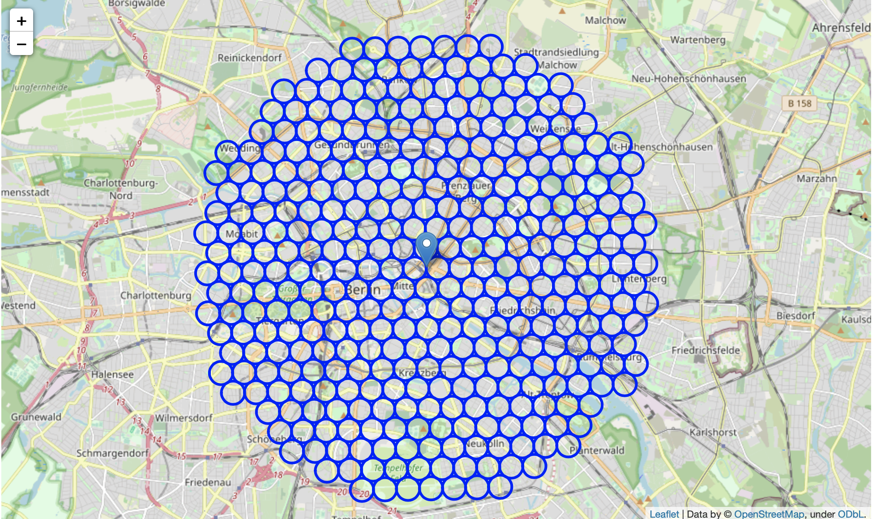
Data

Slide 8
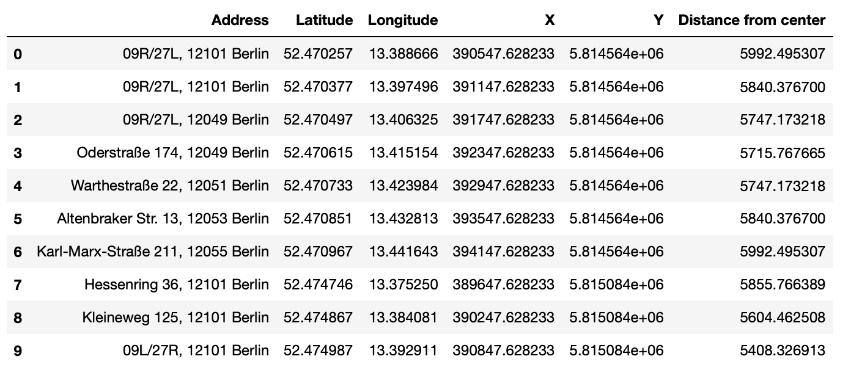
Data
Now we have the coordinates of centers of neighborhoods/areas to be evaluated, equally spaced (distance from every point to its neighbors is exactly the same) and within ~6km from Alexanderplatz. Let's now use Google Maps API to get approximate addresses of those locations.

Slide 9
Data
Foursquare
Since we have our area up-and-comers, we will utilize Foursquare API to get data on cafés in every area.
We're interested in venues in 'food' category, but only those that are proper restaurants - coffe shops, pizza places, bakeries etc. are not direct competitors so we don't care about those. So we will include in out list only venues that have 'restaurant' in category name, and we'll make sure to detect and include all the subcategories of specific 'Italian restaurant' category, as we need info on Italian restaurants in the neighborhood.

Slide 10
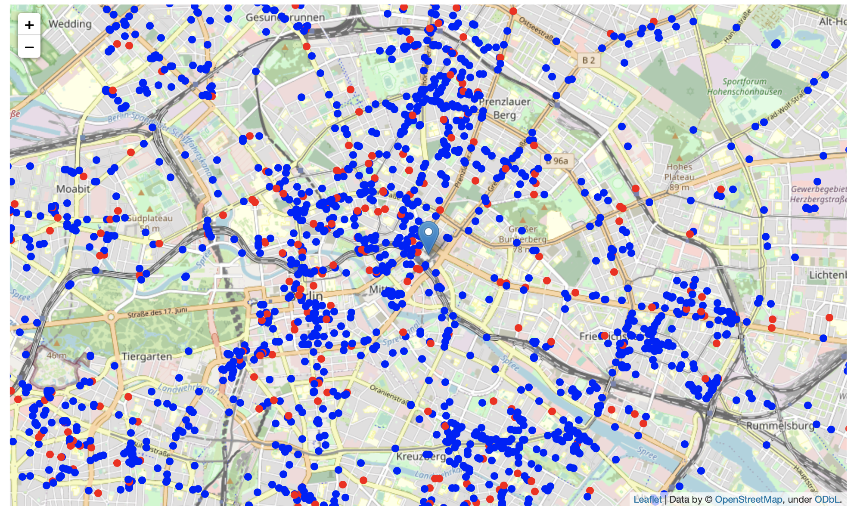
Data

Slide 11
Methodology
In this project we will direct our efforts on detecting areas of Berlin that have low restaurant density, particularly those with low number of Italian restaurants. We will limit our analysis to area ~6km around city center.
In first step we have collected the required data: location and type (category) of every restaurant within 6km from Berlin center (Alexanderplatz). We have also identified Italian restaurants (according to Foursquare categorization).
Second step in our analysis will be calculation and exploration of 'restaurant density' across different areas of Berlin - we will use heatmaps to identify a few promising areas close to center with low number of restaurants in general (and no Italian restaurants in vicinity) and focus our attention on those areas.
In third and final step we will focus on most promising areas and within those create clusters of locations that meet some basic requirements established in discussion with stakeholders: we will take into consideration locations with no more than two restaurants in radius of 250 meters, and we want locations without Italian restaurants in radius of 400 meters. We will present map of all such locations but also create clusters (using k-means clustering) of those locations to identify general zones / neighborhoods / addresses which should be a starting point for final 'street level' exploration and search for optimal venue location by stakeholders.

Slide 12
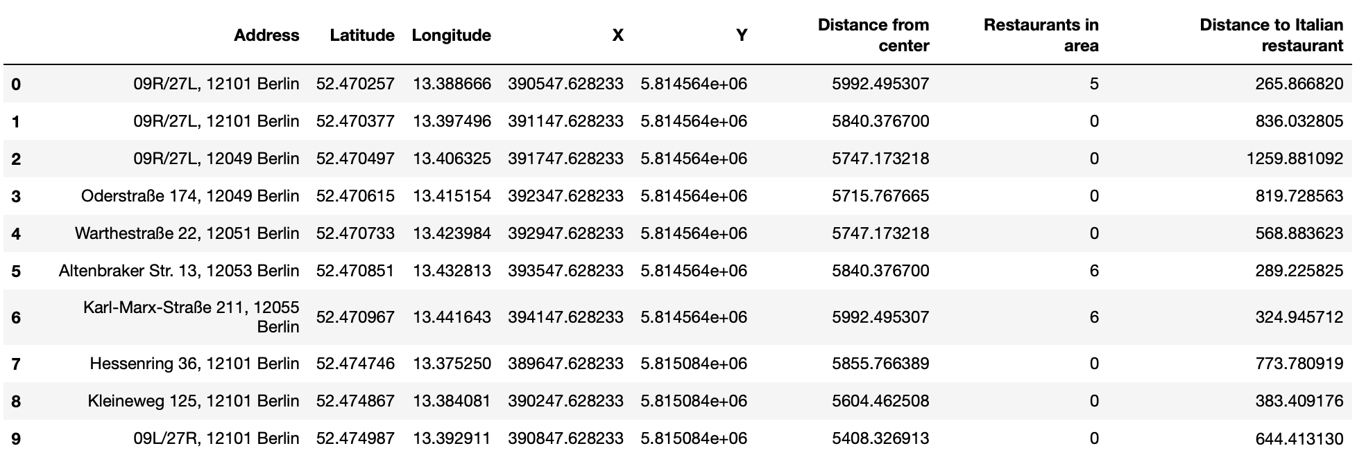
Analysis
First let's count the number of restaurants in every area candidate:
Average number of restaurants in every area with radius=300m: 4.914835164835165

Slide 13
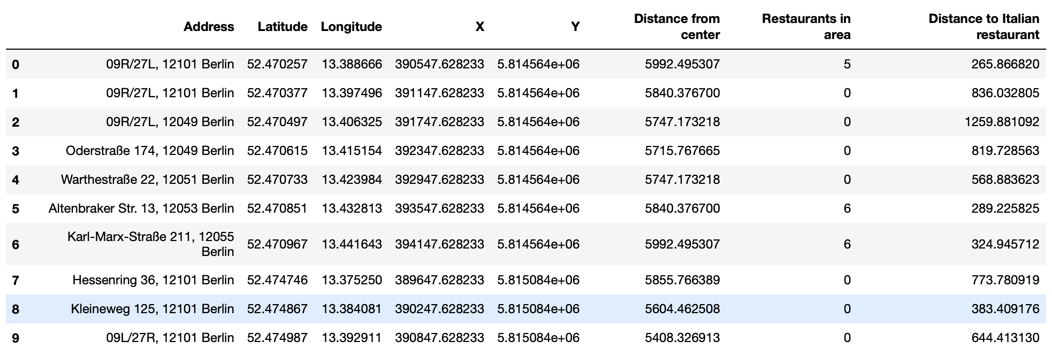
Analysis
Let's calculate the distance to nearest Italian restaurant from every area candidate center (not only those within 300m - we want distance to closest one, regardless of how distant it is).

Slide 14
Analysis
Average distance to closest Italian restaurant from each area center: 478.14622684002745
OK, so on average Italian restaurant can be found within ~500m from every area center candidate. That's fairly close, so we need to filter our areas carefully! Let's crete a map showing heatmap / density of restaurants and try to extract some meaningfull info from that. Also, let's show borders of Berlin boroughs on our map and a few circles indicating distance of 1km, 2km and 3km from Alexanderplatz.

Slide 15
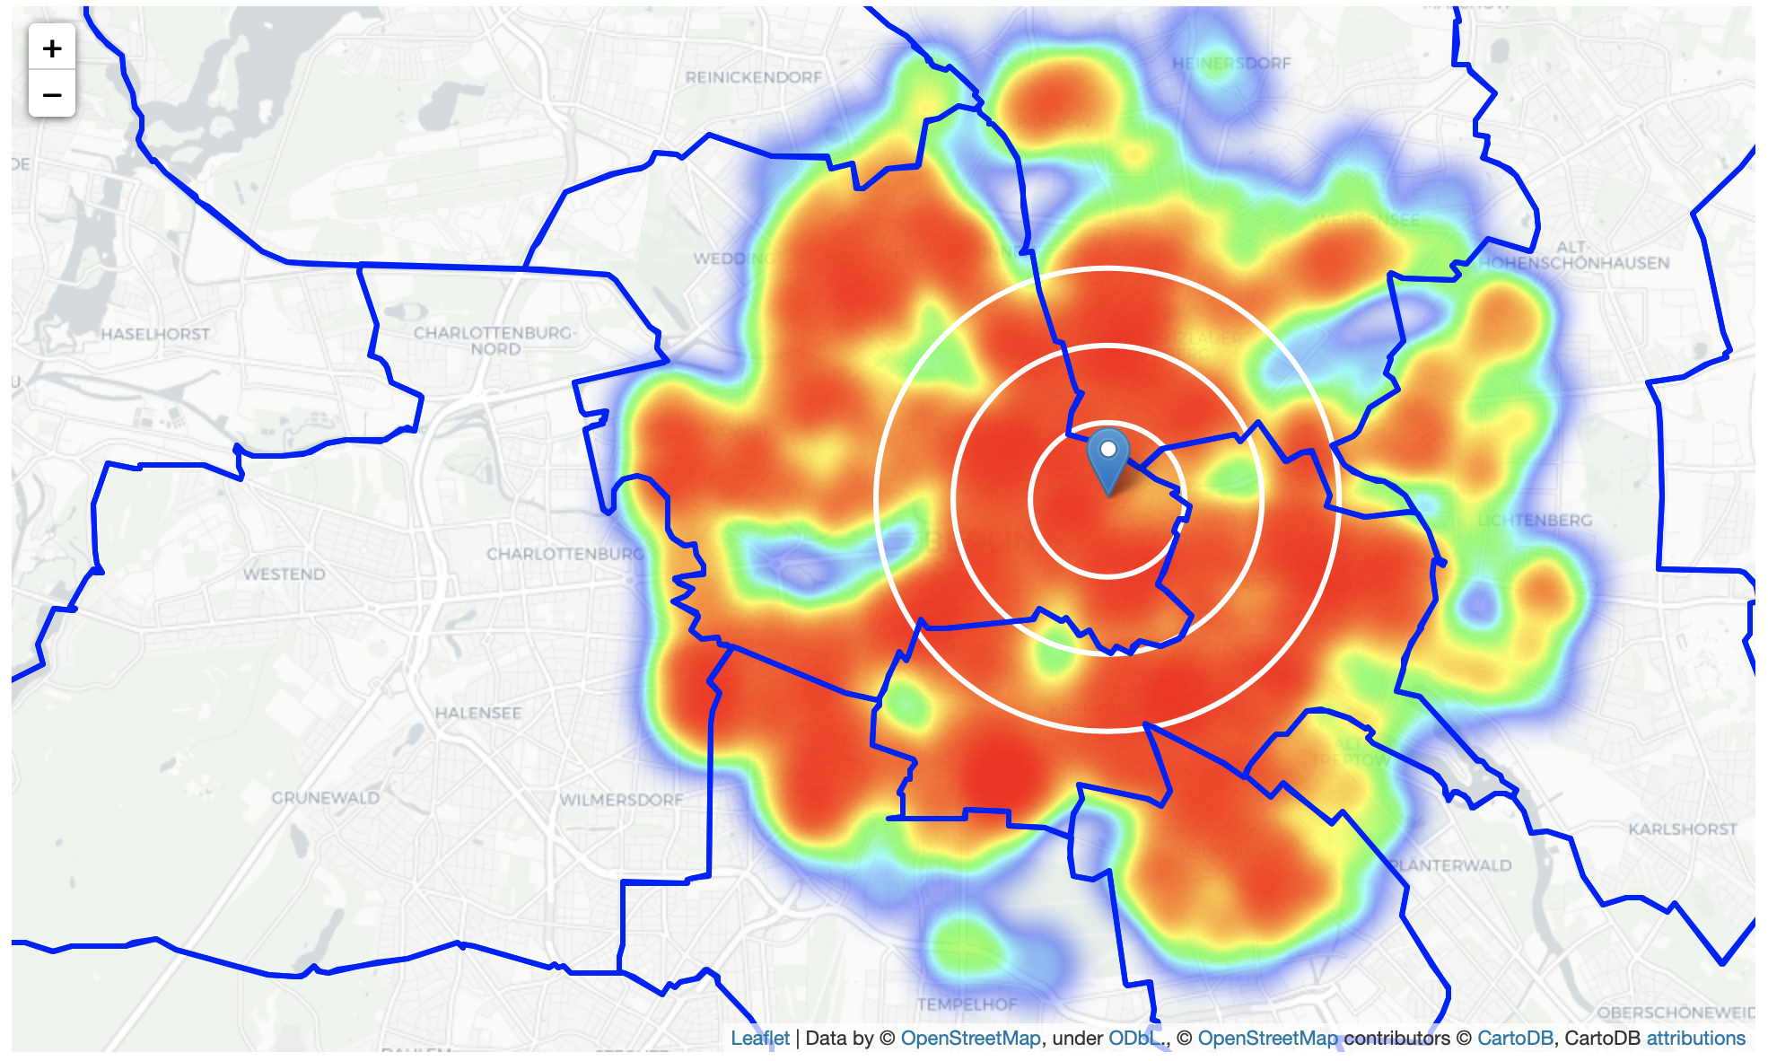
Analysis

Slide 16
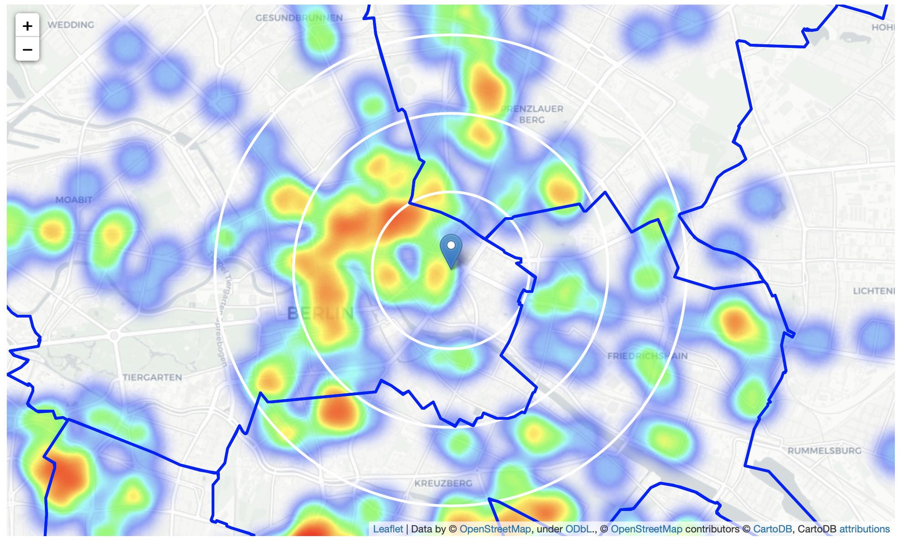
Analysis
Looks like a few pockets of low restaurant density closest to city center can be found south, south-east and east from Alexanderplatz. Let's create another heatmap map showing heatmap/density of Italian restaurants only.

Slide 17
Analysis
Looks like a few pockets of low restaurant density closest to city center can be found south, south-east and east from Alexanderplatz. Let's create another heatmap map showing heatmap/density of Italian restaurants only.

Slide 18
Analysis
This map is not so 'hot' (Italian restaurants represent a subset of ~15% of all restaurants in Berlin) but it also indicates higher density of existing Italian restaurants directly north and west from Alexanderplatz, with closest pockets of low Italian restaurant density positioned east, south-east and south from city center. Based on this we will now focus our analysis on areas south-west, south, south-east and east from Berlin center - we will move the center of our area of interest and reduce it's size to have a radius of 2.5km. This places our location candidates mostly in boroughs Kreuzberg and Friedrichshain (another potentially interesting borough is Prenzlauer Berg with large low restaurant density north-east from city center, however this borough is less interesting to stakeholders as it's mostly residential and less popular with tourists).

Slide 19
Analysis
Kreuzberg and Friedrichshain
Analysis of popular travel guides and web sites often mention Kreuzberg and Friedrichshain as beautifull, interesting, rich with culture, 'hip' and 'cool' Berlin neighborhoods popular with tourists and loved by Berliners.
"Bold and brazen, Kreuzberg's creative people, places, and spaces might challenge your paradigm." Tags: Nightlife, Artsy, Dining, Trendy, Loved by Berliners, Great Transit (airbnb.com)
"Kreuzberg has long been revered for its diverse cultural life and as a part of Berlin where alternative lifestyles have flourished. Envisioning the glamorous yet gritty nature of Berlin often conjures up scenes from this neighbourhood, where cultures, movements and artistic flare adorn the walls of building and fills the air. Brimming with nightclubs, street food, and art galleries, Kreuzberg is the place to be for Berlin’s young and trendy." (theculturetrip.com)

Slide 20
Analysis
"Imagine an art gallery turned inside out and you’ll begin to envision Friedrichshain. Single walls aren’t canvases for creative works, entire buildings are canvases. This zealously expressive east Berlin neighborhood forgoes social norms" Tags: Artsy, Nightlife, Trendy, Dining, Touristy, Shopping, Great Transit, Loved by Berliners (airbnb.com)
"As anyone from Kreuzberg will tell you, this district is not just the coolest in Berlin, but the hippest location in the entire universe. Kreuzberg has long been famed for its diverse cultural life, its experimental alternative lifestyles and the powerful spell it exercises on young people from across Germany. In 2001, Kreuzberg and Friedrichshain were merged to form one administrative borough. When it comes to club culture, Friedrichshain is now out in front – with southern Friedrichshain particularly ranked as home to the highest density of clubs in the city." (visitberlin.de)
Popular with tourists, alternative and bohemian but booming and trendy, relatively close to city center and well connected, those boroughs appear to justify further analysis. Let's define new, more narrow region of interest, which will include low-restaurant-count parts of Kreuzberg and Friedrichshain closest to Alexanderplatz.

Slide 21
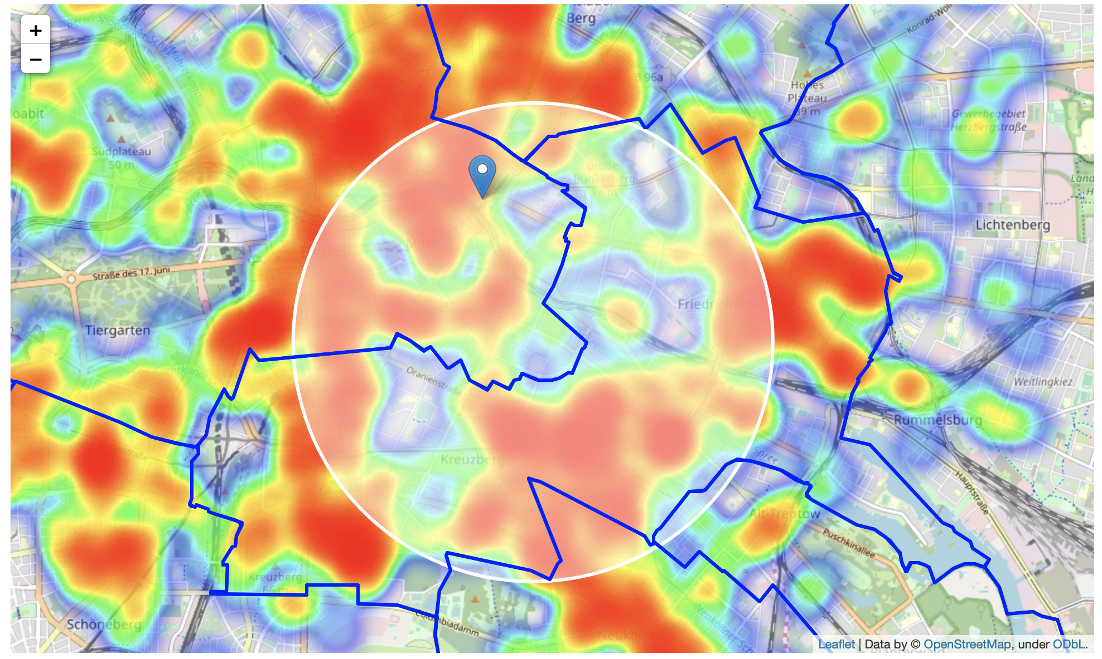
Analysis

Slide 22
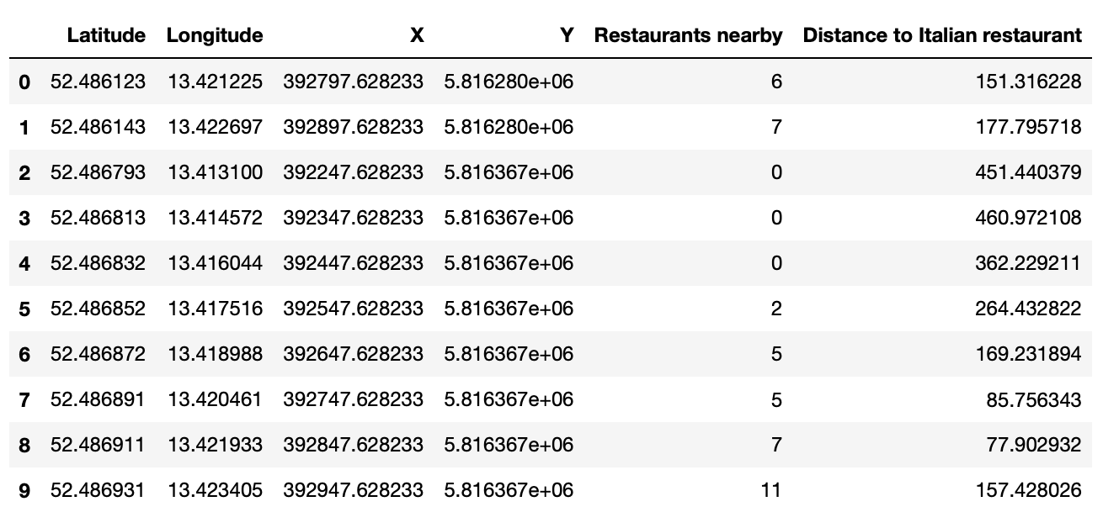
Analysis
Let's calculate two most important things for each location candidate: number of restaurants in vicinity (we'll use radius of 250 meters) and distance to closest Italian restaurant.

Slide 23
Analysis
Let us now filter those locations: we're interested only in locations with no more than two restaurants in radius of 250 meters, and no Italian restaurants in radius of 400 meters.
Locations with no more than two restaurants nearby: 772
Locations with no Italian restaurants within 400m: 382
Locations with both conditions met: 288

Slide 24
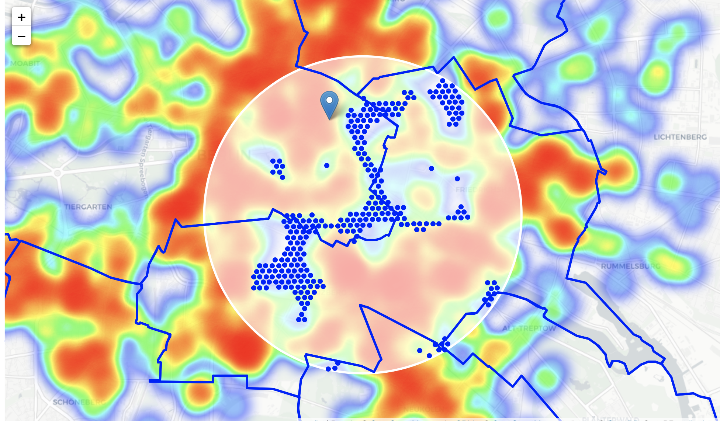
Analysis

Slide 25
Analysis
We now have a bunch of locations fairly close to Alexanderplatz (mostly in Kreuzberg, Friedrichshain and south-east corner of Mitte boroughs), and we know that each of those locations has no more than two restaurants in radius of 250m, and no Italian restaurant closer than 400m. Any of those locations is a potential candidate for a new Italian restaurant, at least based on nearby competition.

Slide 26
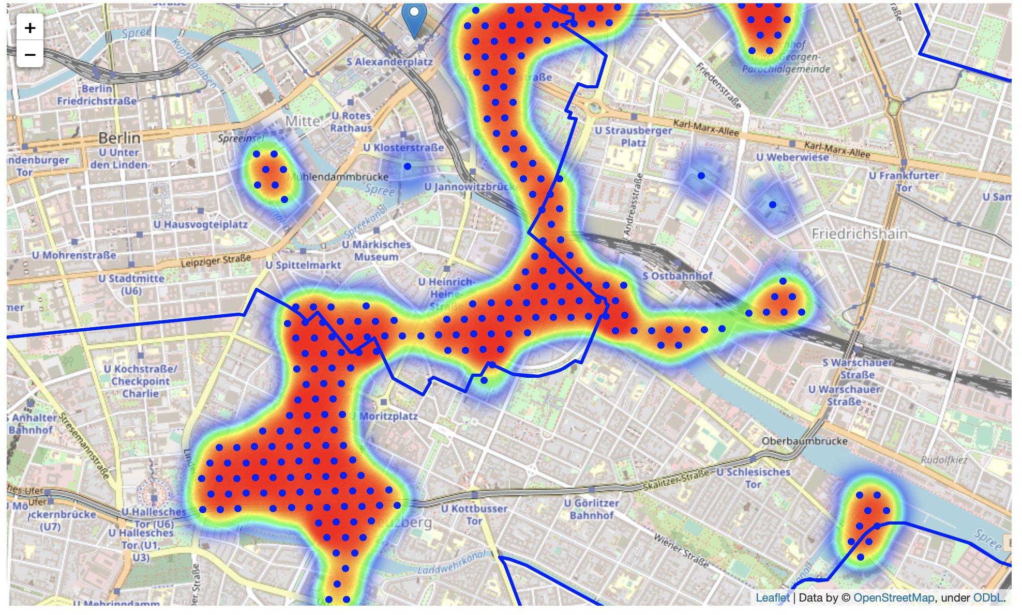
Analysis
Let's now show those good locations in a form of heatmap:

Slide 27
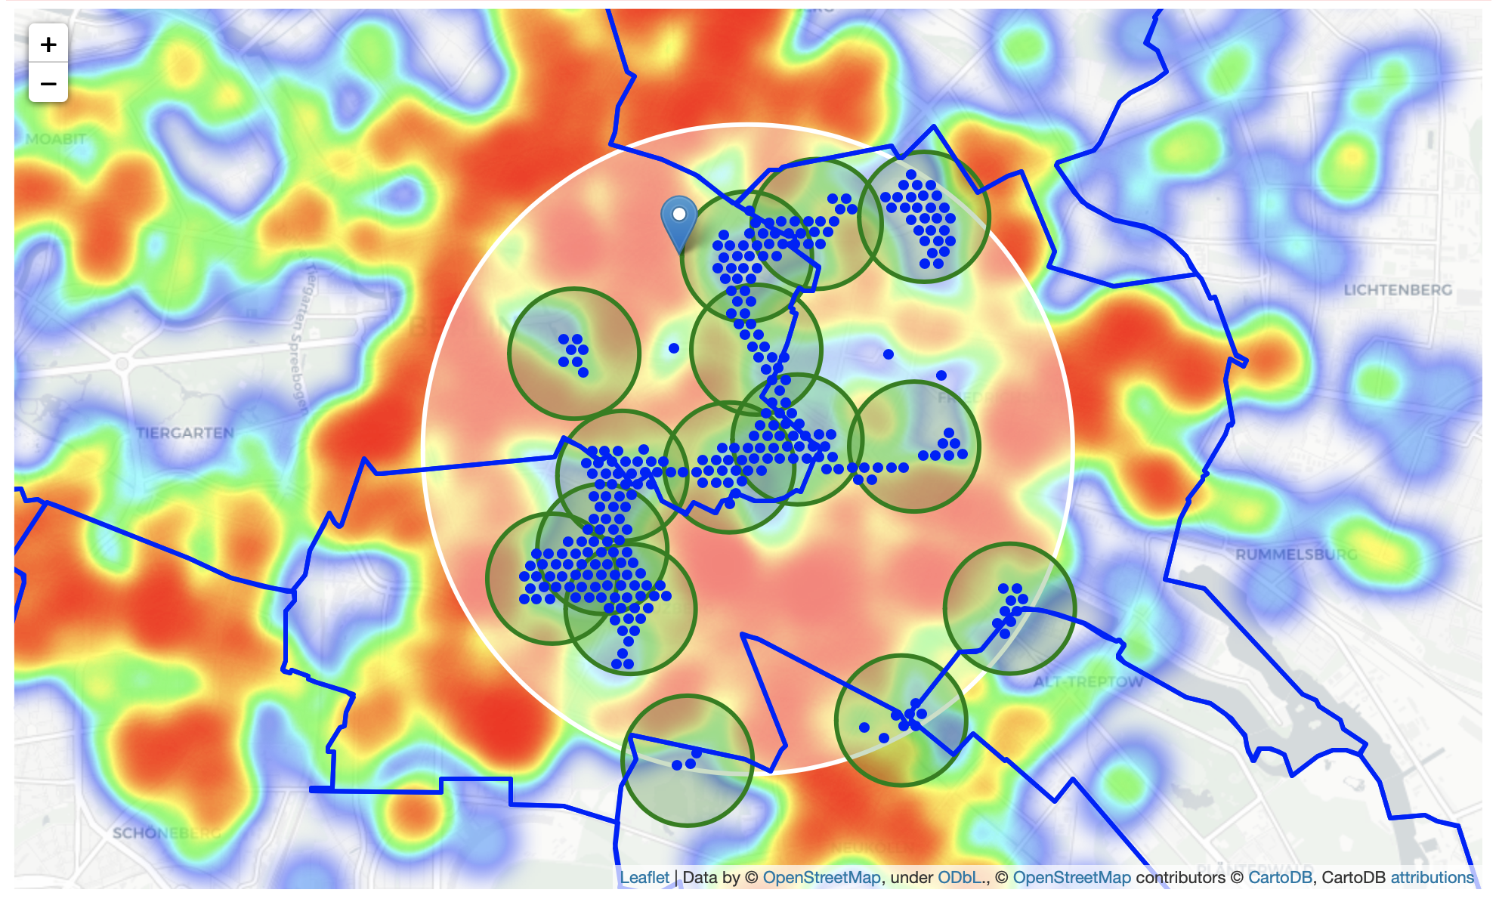
Analysis
What we have now is a clear indication of zones with low number of restaurants in vicinity, and no Italian restaurants at all nearby. Let us now cluster those locations to create centers of zones containing good locations. Those zones, their centers and addresses will be the final result of our analysis.

Slide 28
Analysis
Our clusters represent groupings of most of the candidate locations and cluster centers are placed nicely in the middle of the zones 'rich' with location candidates.
Addresses of those cluster centers will be a good starting point for exploring the neighborhoods to find the best possible location based on neighborhood specifics.
Let's see those zones on a city map without heatmap, using shaded areas to indicate our clusters:

Slide 29
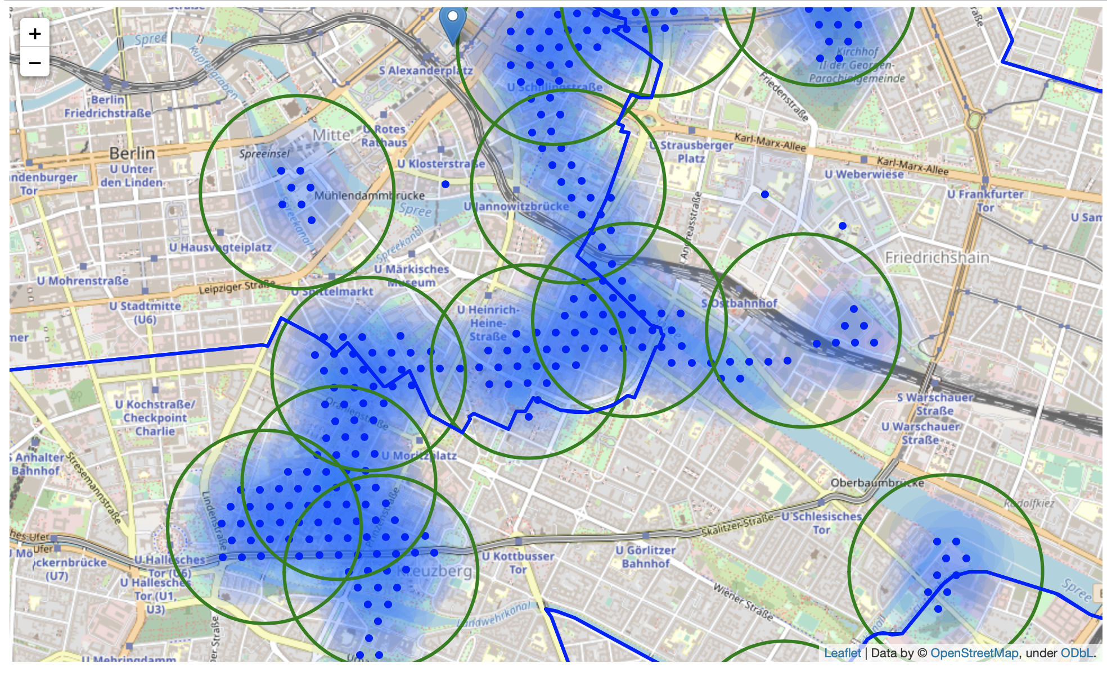
Analysis

Slide 30
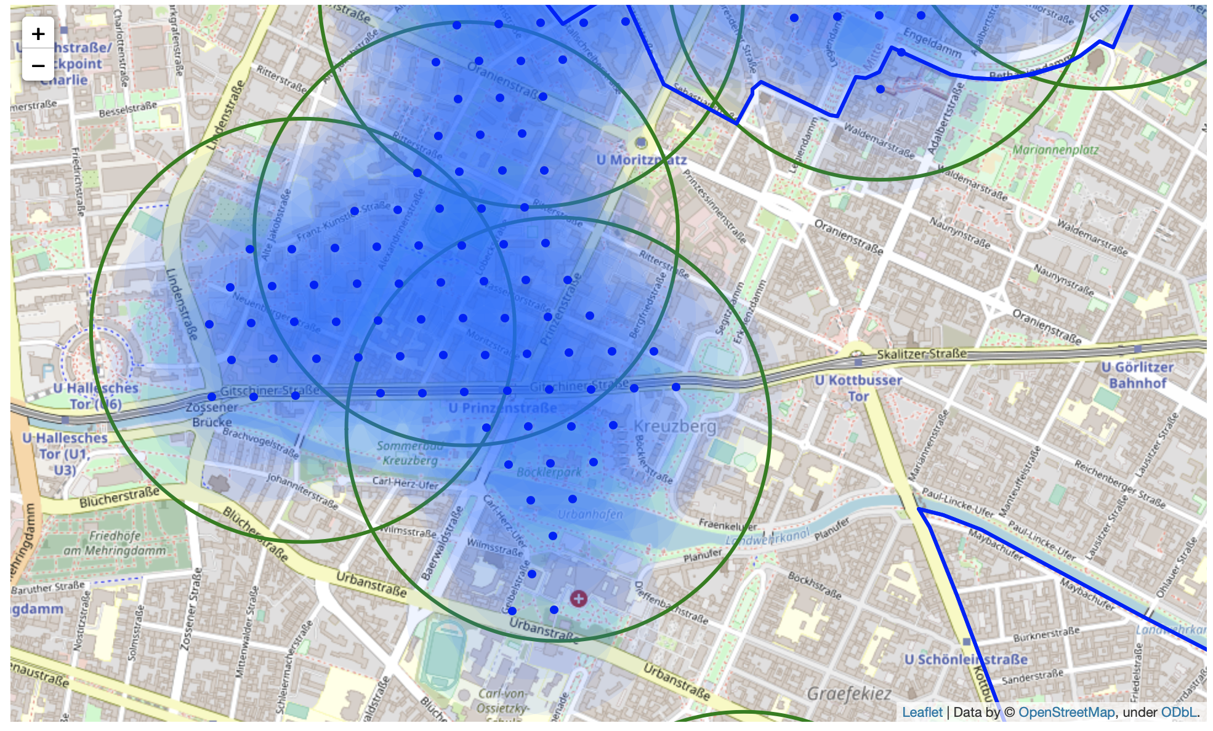
Analysis
Let's zoom in on candidate areas in Kreuzberg:

Slide 31
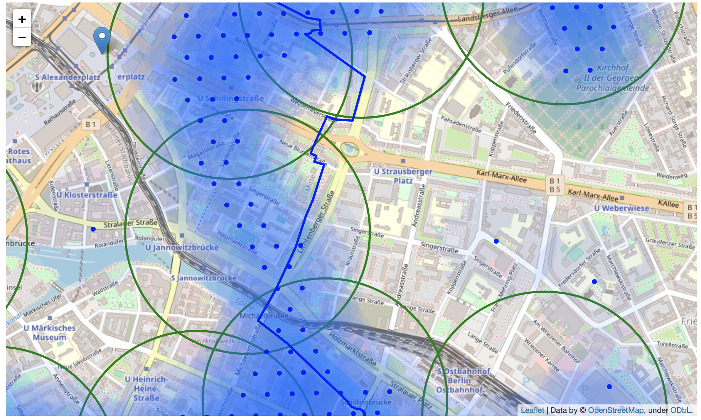
Analysis
...and candidate areas in Friedrichshain:

Slide 32
Analysis
Finaly, let's reverse geocode those candidate area centers to get the addresses which can be presented to stakeholders.
Addresses of centers of areas recommended for further analysis
Berolinastraße 14, 10178 Berlin => 0.5km from Alexanderplatz
Neuenburger Str. 17, 10969 Berlin => 2.7km from Alexanderplatz
Köpenicker Str. 40, 10179 Berlin => 1.7km from Alexanderplatz
Landsberger Allee 37, 10249 Berlin => 1.9km from Alexanderplatz
Vor dem Schlesischen Tor 2, 10997 Berlin => 3.7km from Alexanderplatz
Michaelkirchpl. 15, 10179 Berlin => 1.7km from Alexanderplatz
Schloßpl. 1, 10178 Berlin => 1.1km from Alexanderplatz
Stallschreiberstraße 46, 10969 Berlin => 1.7km from Alexanderplatz
Holzmarktstraße 55, 10179 Berlin => 0.9km from Alexanderplatz
Platz der Vereinten Nationen 30, 10249 Berlin => 1.1km from Alexanderplatz
Maybachufer, 12045 Berlin => 4.0km from Alexanderplatz
Helen-Ernst-Straße 28, 10243 Berlin => 2.3km from Alexanderplatz
Gitschiner Str. 34, 10969 Berlin => 2.7km from Alexanderplatz
Lobeckstraße 62, 10969 Berlin => 2.3km from Alexanderplatz Hundeauslauf, Dog Park, Hasenheide 82, 10967 Berlin => 3.9km from Alexanderplatz

Slide 33
Analysis
This concludes our analysis. We have created 15 addresses representing centers of zones containing locations with low number of restaurants and no Italian restaurants nearby, all zones being fairly close to city center (all less than 4km from Alexanderplazt, and about half of those less than 2km from Alexanderplatz). Although zones are shown on map with a radius of ~500 meters (green circles), their shape is actually very irregular and their centers/addresses should be considered only as a starting point for exploring area neighborhoods in search for potential restaurant locations. Most of the zones are located in Kreuzberg and Friedrichshain boroughs, which we have identified as interesting due to being popular with tourists, fairly close to city center and well connected by public transport.

Slide 34
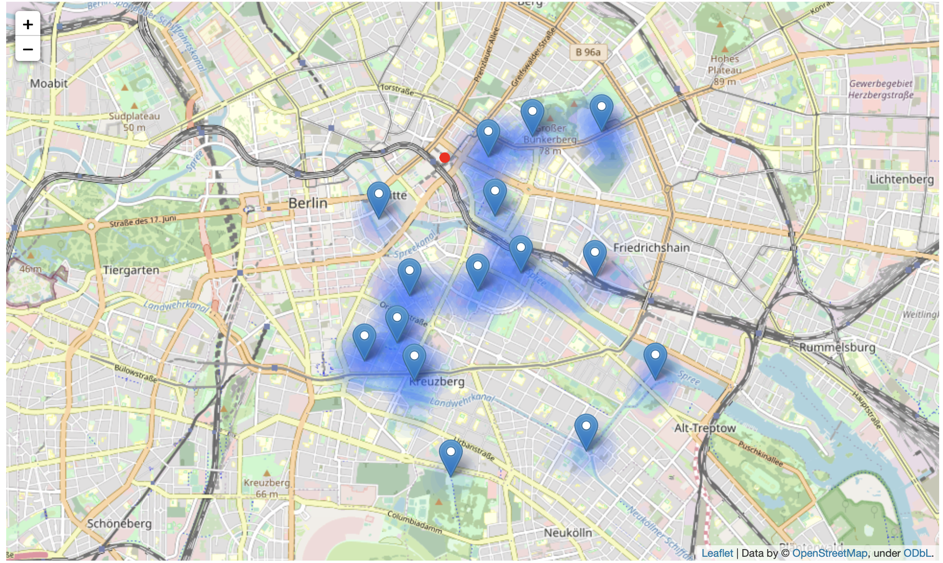
Analysis

Slide 35
Results and Discussion
Our analysis shows that although there is a great number of restaurants in Berlin (~2000 in our initial area of interest which was 12x12km around Alexanderplatz), there are pockets of low restaurant density fairly close to city center. Highest concentration of restaurants was detected north and west from Alexanderplatz, so we focused our attention to areas south, south-east and east, corresponding to boroughs Kreuzberg, Friedrichshain and south-east corner of central Mitte borough. Another borough was identified as potentially interesting (Prenzlauer Berg, north-east from Alexanderplatz), but our attention was focused on Kreuzberg and Friedrichshain which offer a combination of popularity among tourists, closeness to city center, strong socio-economic dynamics and a number of pockets of low restaurant density.
After directing our attention to this more narrow area of interest (covering approx. 5x5km south-east from Alexanderplatz) we first created a dense grid of location candidates (spaced 100m appart); those locations were then filtered so that those with more than two restaurants in radius of 250m and those with an Italian restaurant closer than 400m were removed.

Slide 36
Results and Discussion
Those location candidates were then clustered to create zones of interest which contain greatest number of location candidates. Addresses of centers of those zones were also generated using reverse geocoding to be used as markers/starting points for more detailed local analysis based on other factors.
Result of all this is 15 zones containing largest number of potential new restaurant locations based on number of and distance to existing venues - both restaurants in general and Italian restaurants particularly. This, of course, does not imply that those zones are actually optimal locations for a new restaurant! Purpose of this analysis was to only provide info on areas close to Berlin center but not crowded with existing restaurants (particularly Italian) - it is entirely possible that there is a very good reason for small number of restaurants in any of those areas, reasons which would make them unsuitable for a new restaurant regardless of lack of competition in the area. Recommended zones should therefore be considered only as a starting point for more detailed analysis which could eventually result in location which has not only no nearby competition but also other factors taken into account and all other relevant conditions met.

Slide 37
Conclusion
Those location candidates were then clustered to create zones of interest which contain greatest number of location candidates. Addresses of centers of those zones were also generated using reverse geocoding to be used as markers/starting points for more detailed local analysis based on other factors.
Result of all this is 15 zones containing largest number of potential new restaurant locations based on number of and distance to existing venues - both restaurants in general and Italian restaurants particularly. This, of course, does not imply that those zones are actually optimal locations for a new restaurant! Purpose of this analysis was to only provide info on areas close to Berlin center but not crowded with existing restaurants (particularly Italian) - it is entirely possible that there is a very good reason for small number of restaurants in any of those areas, reasons which would make them unsuitable for a new restaurant regardless of lack of competition in the area. Recommended zones should therefore be considered only as a starting point for more detailed analysis which could eventually result in location which has not only no nearby competition but also other factors taken into account and all other relevant conditions met.

Slide 38
Thank You

